Slide 1
ASSET:
An Embedded Systems Design Methodology
Prof. M.Balakrishnan
Embedded Systems Group,
IIT Delhi, India
18th Dec. 2000
Sponsored by
Naval Research Board, Government of India

Slide 2
Overview
Introduction & Methodology
Processor selection
Hardware-software partitioning
Kernel Synthesis
Visualisation and analysis of platforms
ASIP Synthesis
Future work

Slide 3
Motivation
Drive towards automated system design
In this project we target computation dominated embedded systems
The methodology is based on using ESIR as the intermediate representation with tools adding (and reading) annotations to it.

Slide 4
ESIR
Embedded Systems Internal Representation
Storehouse of information
Uses SUIF for providing the data structures
SUIF annotations used to add information to the application syntax tree

Slide 5
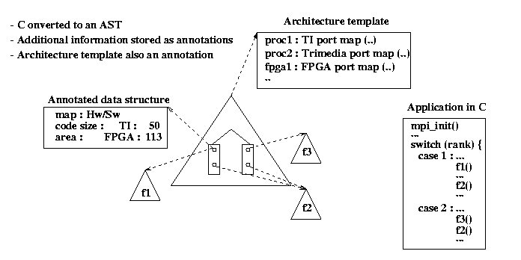
Example

Slide 6
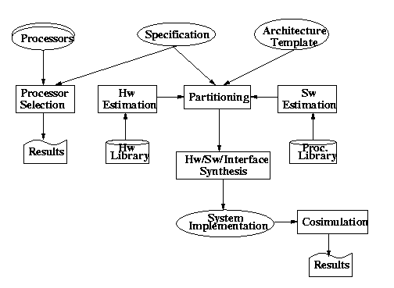
Methodology

Slide 7
Specification
Application specification at 2 Levels
  Abstract control flow in Esterel Language
    Formal specification and verification
    Constraint consistency checking
    Architecture exploration by high-level modeling
  Refined procedural specification in C
    Good for specification of large systems
    Available software
    Extendible using MPI & pThreads

Slide 8
MPI (Message Passing Interface)
Concurrent processes
Point to point communication
Blocking and non blocking calls
No shared memory
A subset selected

Slide 9
Pthreads (POSIX threads)
Multiple threads
Create and join calls
Shared memory
A subset selected
Each MPI process allowed to have multiple threads

Slide 10
Constraints
Specified as comments in C code
Have a defined grammar
Rate, timeout, latency constraints
Inter and intra process constraints

Slide 11
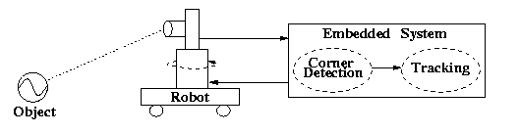
Case Study
Tracking application
  Vision based
  Computation intensive

Slide 12
Hardware Estimation
Hardware estimation for two target technologies
  ASICs
  FPGA
Hardware estimation involves estimate of
  Performance based on number of clocks and clock period estimate
  Cost using area or CLBs

Slide 13
Hardware Estimation (contd)
Schedule length (or number of clocks) estimation
  Operator use method for the upper bound
  Mobility based method for the lower bound
Clock period estimation
  Optimal clock using slack minimization
Operator and memory componnts: area and delay
  ASIC library
  FPGA library

Slide 14
Software Estimation
Software estimation follows essentially the procssor selection flow
Input: Application (SUIF) with profile information + Machine description (resources + delays)
+ Special instructions
Output: Estimated performance

Slide 15
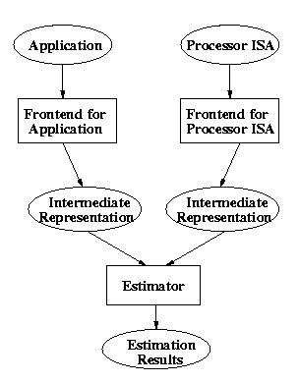
Processor Selection
Matching application
with the processors
Identification of application
characteristics
Capturing processor features
Software estimation

Slide 16
Processor Architecture
Types of functional units and their properties
Number of each type available
Number of registers
Slots for each operation
Load/Store in parallel

Slide 17
Application Parameters
Average block size
Number of mac operations
Address ALU utilization
Memory bandwidth requirement
ASAP schedule and average arc length

Slide 18
Constraint Scheduler
Scheduling application on processor
Profiler results used
Assumptions -
  Infinite register file
  All operations on registers
  All blocks executed sequentially
  First fit heuristic for mapping functions to FUs

Slide 19
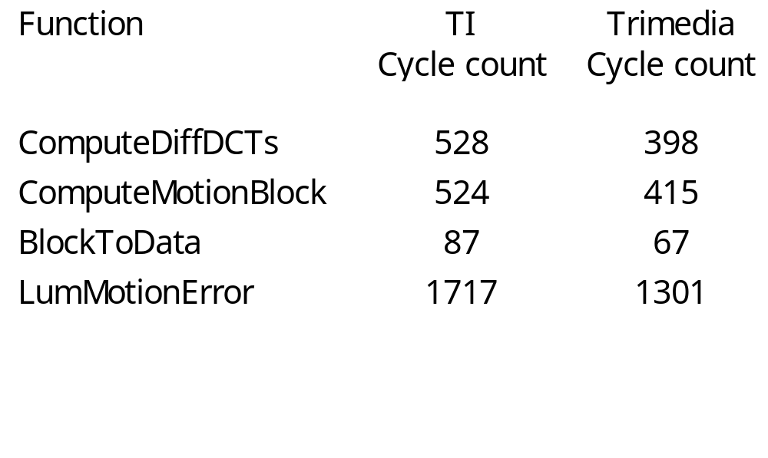
Results (MPEG Case Study)

Slide 20
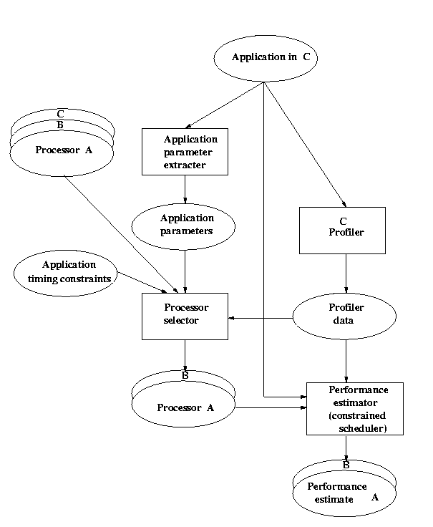
Processor Selection Design Flow

Slide 21
Partitioning
Process/function level partitioning
Scheduling and binding of tasks onto hw & sw resources
Objective is to minimize total execution time or to meet a specific time constraint
Problem model
  Single processor with a single bus and multiple ASICs
  Concurrent execution of resources
  Communication overheads

Slide 22
Target Architecture
Processor
Bus
_{ASIC1}
_{ASIC2}
_{ASIC3}
_{ASIC4}

Slide 23
Problem modeling
Linear programming
  0-1 Integer linear programming
  Integer linear programming
Dynamic Programming

Slide 24
Inputs
Dependency graph
Hardware resources: type and number
Software time estimate for each computation node
Hardware time estimate for each computation node
Communication time estimates for each communication node

Slide 25
Modes of communication tasks
Four modes :
SW
SW
HW
HW
SW
HW
SW
HW
SW
HW
Different communication costs
associated with different modes
CM

Slide 26
0-1 ILP Formulation: Constraints
Dependency Constraints.
  Start time of a node should be more then finish time of all its predecessors
Software Resource Constraints
  Not more than one task can be mapped to software at any one time instance
Hardware Resource constraints
  Assuming K_{i} resources are available for implementing functions of type i, not more than K_{i} functions of type i can be scheduled concurrently

Slide 27
0-1 ILP: Constraints (contd.)
Bus Constraints
  Only one communication node can be scheduled at any one time
Communication mode
  For each communication only one mode of operation should be selected (SW-SW, SW-HW, HW-SW and HW) and the selected mode should be such that it is consistent with the mapping of predecessor and successor nodes

Slide 28
General ILP Formulation
Removed time index to reduce the number of variables
Introduced sequencing variables to represent execution order

Slide 29
Analysis & Comparison
Task Graph of 5 nodes & 6 edges
0-1 ILP Formulation
  variables 2073
  constraints 2658
  No. of vars = O( time *(|tasks| + |edges|)
General ILP Formulation
  variables 114
  constraints 309
  No. of vars = O( K* |task| + |tasks| ² + |edges|²) where K is the maximum number of resource of same kind.

Slide 30
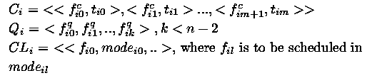
Dynamic Programming Approach
State is the triplet <C_{i},Q_{i},CL_{i}>
  C_{i} denotes configuration after ith step
  Q_{i} denotes Queue of functions after ith step
  CL_{i} denotes constraint list on the nodes to be scheduled later.

Slide 31
Generating next state
Pick the task that finishes first.
Examine each child of this task and if all its predecessors have finished, add it to the ready queue
Try each possible subset of functions from the ready queue and try to schedule it on the free resources

Slide 32
Pruning the Search Space
Estimated time from each state to prune search space.
  This estimate is the lower bound on the time it takes using the present state as the starting state i.e.
  Actual Execution time >= Estimated time
Nodes that have higher estimate than the current minimum are pruned.
Order in which states are visited is important.
Estimate is obtained by considering the optimum solution for each possible thread

Slide 33
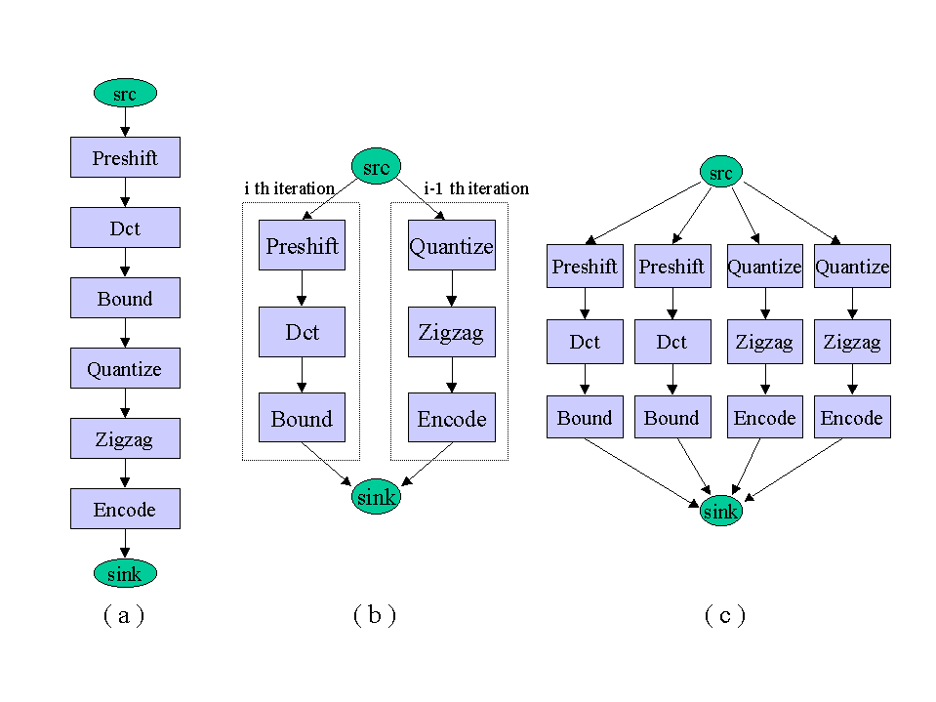
JPEG Example
Loop Pipelining of JPEG System

Slide 34
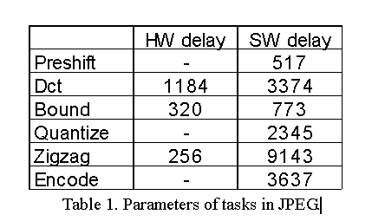
JPEG example
Xilinx FPGA
32bit RISC microprocessor
Communication delay = 4096
Zigzag has been mapped to Hardware
Others mapped to Software

Slide 35
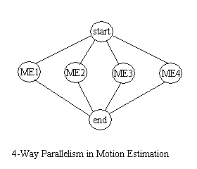
MPEG Encoder
Time Consumed in Motion estimation
Loop Parallelism in Motion estimation
Broadcast model of communication was incorporated

Slide 36
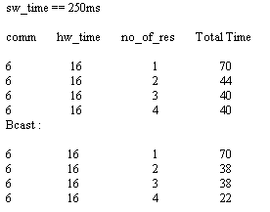
MPEG Results

Slide 37
Results
Synthetic graphs as well as parallel versions of algorithms like Merge sort, Matrix Multiplication, Floor Plan Optimisation, MPEG and JPEG decoders
With Pruning the number of iterations decreased in most cases by a factor of upto 10⁶
Memoised version was tried and it reduced the number of iterations by almost 100 in many cases
Running time for the graphs with 10 to 25 computation nodes took less than couple of minutes

Slide 38
Future Work
Branches and Loops
Hierarchical and cyclic task graphs
Choice of Shared memory model for communication
Incorporating HW area optimisation as part of the objective function

Slide 39
SUIF to VHDL
C mapped to Behavioral VHDL
Each MPI process mapped to separate VHDL process
User specified mapping of arrays to local/global memories
Generated code verified using

Slide 40
Software Synthesis
Software synthesis would be performed using
Standard compilers
Retargetable code-generators (in case of ASIPs)

Slide 41
Interface Synthesis
Objective
  Estimating communication time requirements from process-resource mapping and architectural inputs
Achievements
  Communication time model for Pentium-Trimedia communication over the PCI bus has been built

Slide 42
Kernel Synthesis Objectives
To synthesize a customized kernel supporting :
process and thread management
real time scheduling and timing guarantees for tasks
relevant device drivers
portability

Slide 43
Task Description
Type of task : periodic or not
Periodicity (if periodic)
Release time
Execution time
Deadline
Recovery task

Slide 44
Real Time Scheduling
Timing guarantees
  via scheduling policies
Some scheduling policies
  EDF
    optimal
  LLF
    minimizes maximum lateness

Slide 45
Design of Kernel
Timer Interrupt
  comes at regular intervals
  used to maintain system wide time
Software Interrupt (system call)
  system call handler (new_thread, thread_exit etc.)
Context switching
  state of a thread
  savestate-schedule-loadstate

Slide 46
Portability Issues
Kernel written mostly in C
Separating machine dependent parts of kernel
  interrupt handling
  context switch
“C interface to chip”
  for x86 - OSKIT (Univ. of Utah)
  for Trimedia - the Trimedia software kit

Slide 47
Custom kernel synthesis
Motivation : optimize for size
Developer chooses which parts of kernel his application requires
  system calls
  device drivers
Genmf - a generic tool for custom kernel synthesis

Slide 48
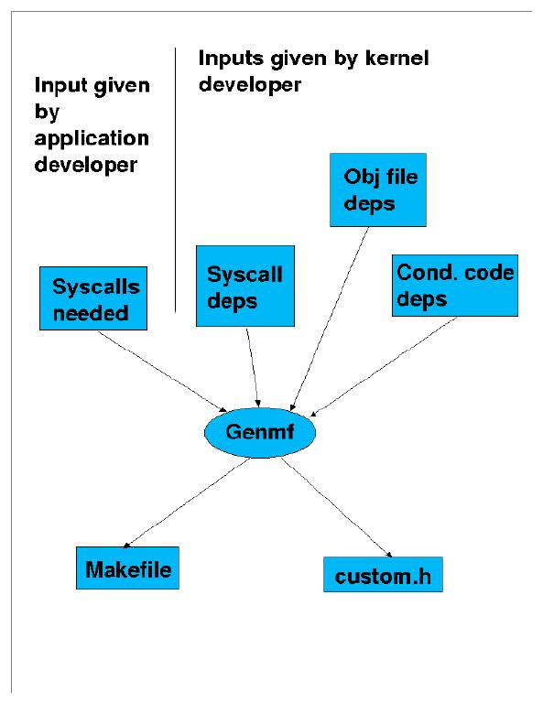
Generating a custom kernel

Slide 49
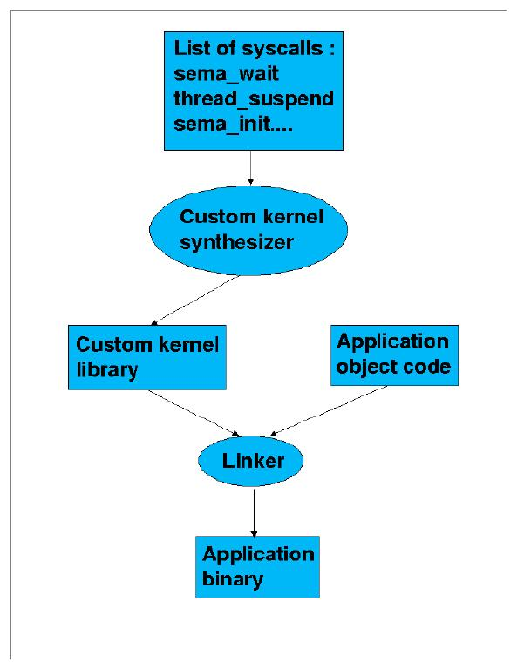
Development Flow

Slide 50
Status
Boots and runs on Intel 386+ and Trimedia
Threads with task description
Real time pre-emptive scheduling
Pluggable scheduling algorithm
Semaphores
VGA for graphics display, Frame grabber on Intel platforms
Three vision applications ported to both Intel and TriMedia; namely collision detection, tracking and motion segmentation

Slide 51
Kernel Synthesis: Future Work
Integrating the three vision applications on one platform
Porting it onto our kernel with implementations on both Pentium and Trimedia platforms
Making measurements for quantifying the context switch tima and other such parameters required by the partitioner

Slide 52
Integration & Testing
A frontend for integration and visualization supporting the following is being developed.
  Application specification (multiple processes in C)
  Architecture specification (cpu, memories, buses & ASICs)
  Binding (manual and using partitioner)
  Estimation (hw, sw and interface)
  Synthesis (hw, sw and kernel)
  Visualization of estimation results
Testing of the three vision benchmarks
Validation using commercial synthesis and cosimulation tools

Slide 53
Associated Research Activities
Platform analysis and visualization by simulation using probabilistic IO models of components
Communication time estimation, performance analysis and interface synthesis for applications with specified QoS
A methodology for ASIP synthesis as a replacement for processor selection

Slide 54
Platform Analysis & Visualization
Inputs: Architecture formed by instantiating components from the library + Application tasks analyzed for extracting certain parameters + Binding
Library: Components and their IO communication models (probabilistic)
Outputs: Feasibility and bus bandwidth utilization with a view to explore binding as well as choose appropriate communication media
Process: Cycle by cycle simulation of the instantiated component models

Slide 55
Interface Synthesis for Applications with QoS Specs
Multi-Media as well as many network applications have a QoS specs
Design for worst-case (ignoring QoS) can be very expensive and wasteful
Interface synthesis and communication bandwidth requirement analysis under QoS requirements is being analysed

Slide 56
ASIP Synthesis
This work is being carried out in collaboration with Dortmund University, Germany under a DST-DAAD exchange collaboration project
Broad responsibilities
  Application analysis and architecture synthesis: IIT Delhi
  Retargetable code generation: Dortmund University
First task: Customizing the LEON processor
In the modified design flow, ASIP synthesis replaces the processor selection step.

Slide 57
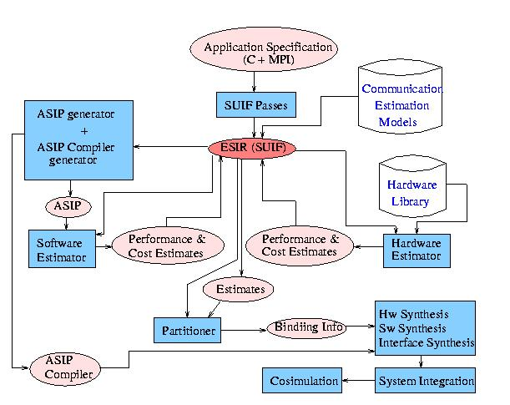
Modified Methodology

Slide 58
ASIP Design Steps
Application analysis
Architecture design space exploration
Instruction set generation
Code synthesis
Processor synthesis

Slide 59
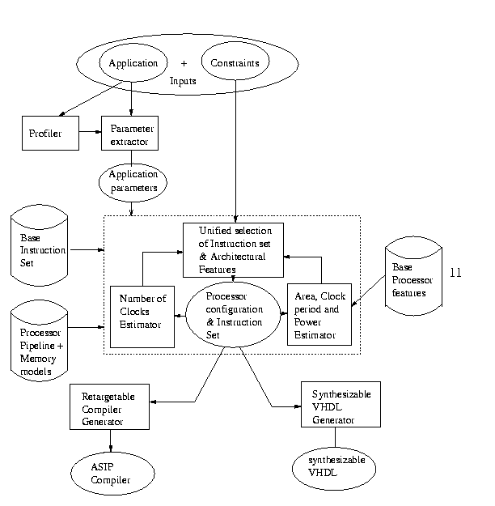
ASIP Design Flow

Slide 60
Work in Progress
Parameterizing the synthesizable VHDL model of LEON
Area, delay and power models of LEON processor components
Extracting application parameters for deciding number of register windows
Effect of register file size on application performance and power consumption

Slide 61
Reference
All technical reports and status reports on the project are available at
http://www.cse.iitd.ernet.in/esproject

